Slide 1
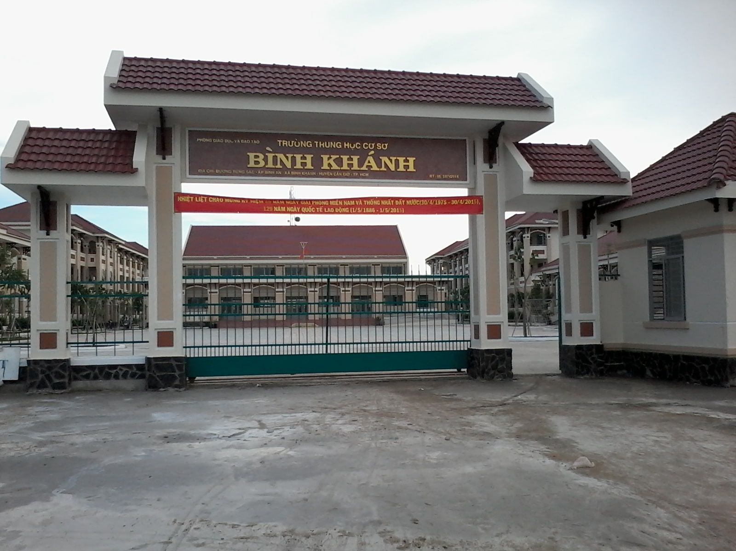



BINH KHANH SECONDARY SCHOOL
FRIENDS PLUS 6

Slide 2

PELMANISM

Slide 3
1
2
3
4
swim
won
win
started
5
6
7
8
see
play
decided
decide
10
played
swam
9
11
12
start
saw

Slide 4

How was your weekend?

Slide 5

UNIT 6
SPORTS
Lesson 6: SPEAKING

Slide 6
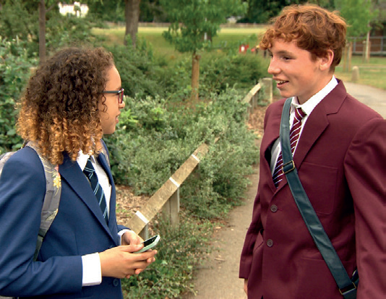
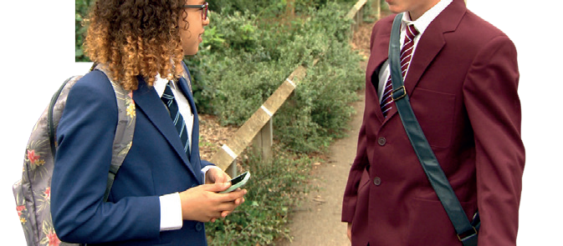
Who are they?
Lois
Alfie

Slide 7

Complete the dialogue. Then watch or listen and check. Why was Alfie happy on Saturday?
Alfie : Hey, Lois. How are things?
Lois : Oh hi, Alfie. Good, thanks. How (1) _______ your weekend?
Alfie : It (2) _______ great, thanks. I (3) ________ to a football match on Saturday.
Lois : Really? (4) ________ it good?
Alfie : Yes, it was brilliant. There (5) _______ a lot of goals. United (6) _______ 3–2 in the end.
Lois : That’s good news! Who (7) ________ you with?
Alfie : My brother. Why don’t you come next time?
Lois : Sure. Why not? Text me when you’re going, OK?
Alfie : OK then. Bye, Lois.
Lois : Bye.
was
was
went
Was
were
won
were

Slide 8
Look at the Key Phrases. Cover the dialogue and try to complete the Key Phrases. Then watch or listen and check.

Slide 9
KEY PHRASES
Talking about the weekend
1) __________ was your weekend?
2) __________ good / bad news!
3) __________ were you with?
4) __________ don’t you come next time?
5) Sure. _________ not?
6 ) Text me __________ you’re going.
How
That’s
Who
Why
Why
when

Slide 10
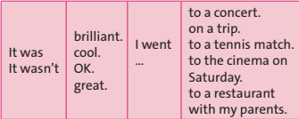
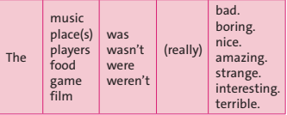
Look at the phrases. Then listen to three mini-dialogues. Which phrases do you hear?

Slide 11
Look at the phrases. Then listen to three mini-dialogues. Which phrases do you hear?
It wasn’t great. I went to the cinema on Saturday. The film was really
boring.
2) It was brilliant. I went to a tennis match. The game was amazing.
3) It was OK. I went to a restaurant with my parents. The food was nice.

Slide 12

Pair-work

Slide 13

Practise mini-dialogues using the phrases in exercises 2 and 3.
Example:
* Student 1: How was your weekend?
* Student 2: It was great. I went to the restaurant with my parents and the food was so delicious. You should go there and try.
* Student 1: Sure. Why not?

Slide 14

Work in pairs. Look at the pictures. Imagine that you went to a football match or basketball game last weekend. Prepare and practise new dialogues with the phrases in exercises 2 and 3.

Slide 15
OPTIONAL ACTIVITY

Slide 16
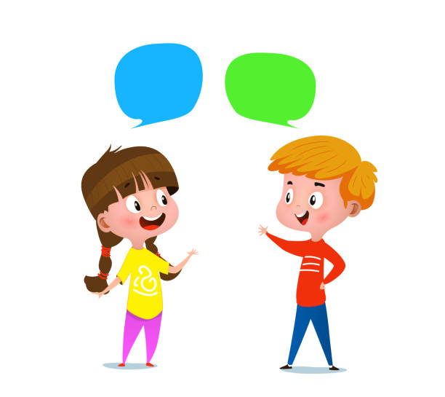
Make a dialogue to tell your partner what you really did last weekend.

Slide 17
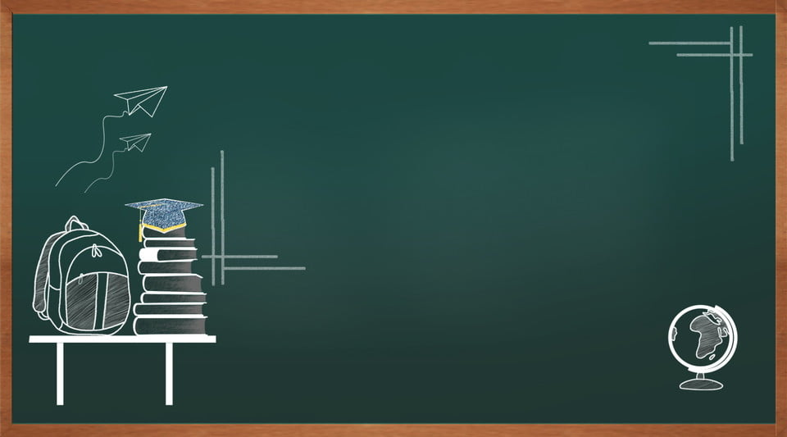
Homework
- Learn by heart all structures.
- Write some sentences about your last weekend, using the Key Phrases in exercise 2 and 3
- Prepare the next lesson: WRITING

